Slide 1
Mindfulness and meditation better brains, moods, and outcomes
Subtitle

Slide 2
Actress Judy Greer says, meditation “creates so much more time for you”

Slide 3
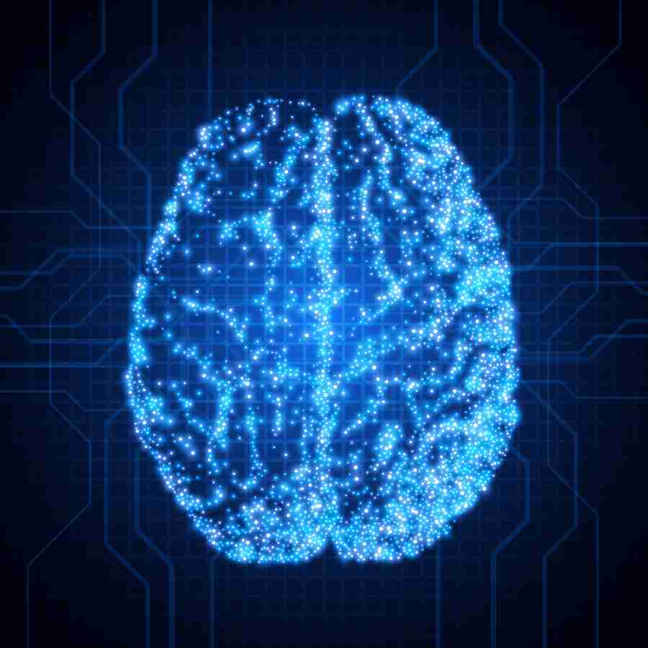
Better brains

Slide 4
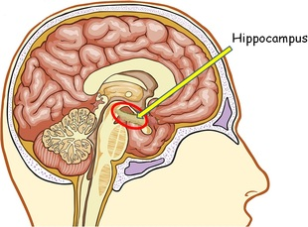
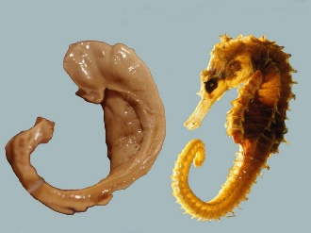
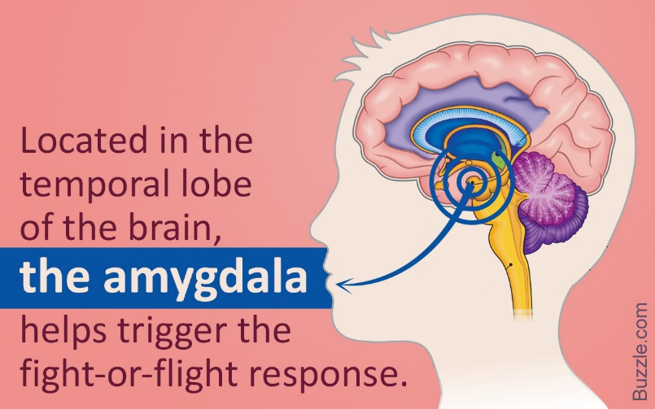
Meditating brain
Hippocampus
Posterior Cingulate
Temporo Parietal Junction
Amygdala

Slide 5
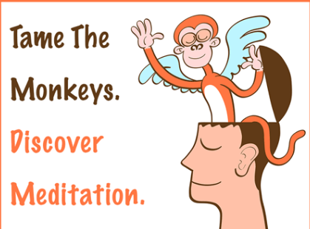
Better moods
ENDORPHINS
PRESENT MOMENT

Slide 7
BETTER OUTCOMES
Students who meditate perform better in school, and handle academic stress more efficiently.
Research shows that meditation leads to increased EQ and IQ levels, improved mental function,
and better grades

